Slide 1
Transformer Protection,

Slide 2
Transformer Fault Categories
Winding and terminal faults
2. Sustained or un-cleared external faults
3. Abnormal operating conditions such as overload, overvoltage and over fluxing
4. Core faults

Slide 3
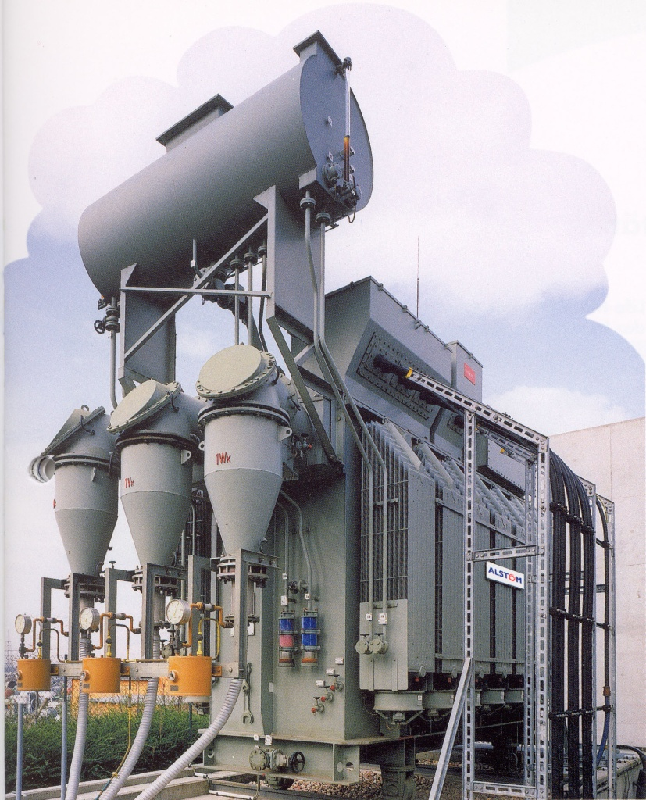
Transformer fault
Electrical Loading
– Over voltages
Thermal Loading
– Aging of the Insulation
Mechanical Load
– Breaks near by the Terminals
– Breaks near by the On Load Tap changer

Slide 4
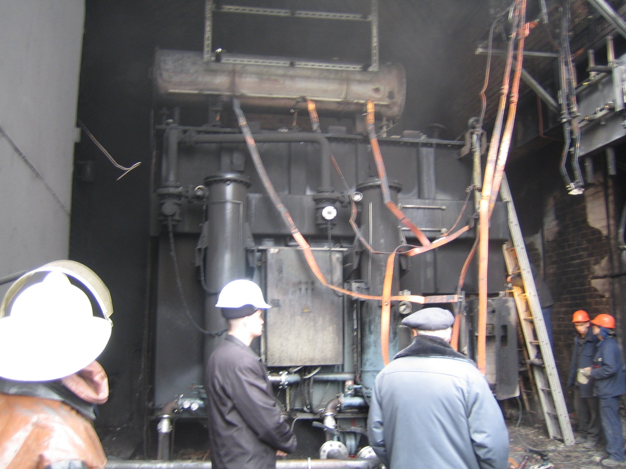
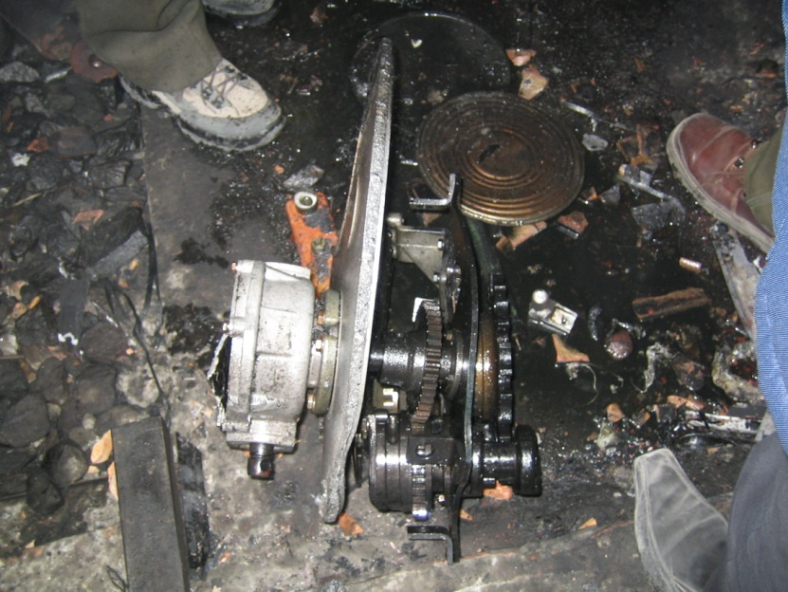
Transformer fault
Explosion at Load Tap Changer

Slide 5
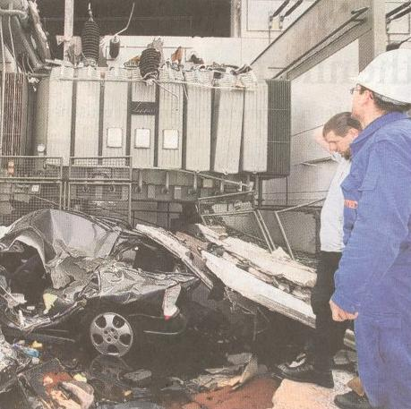
Transformer fault
Mechanical Break near by the Terminals

Slide 6
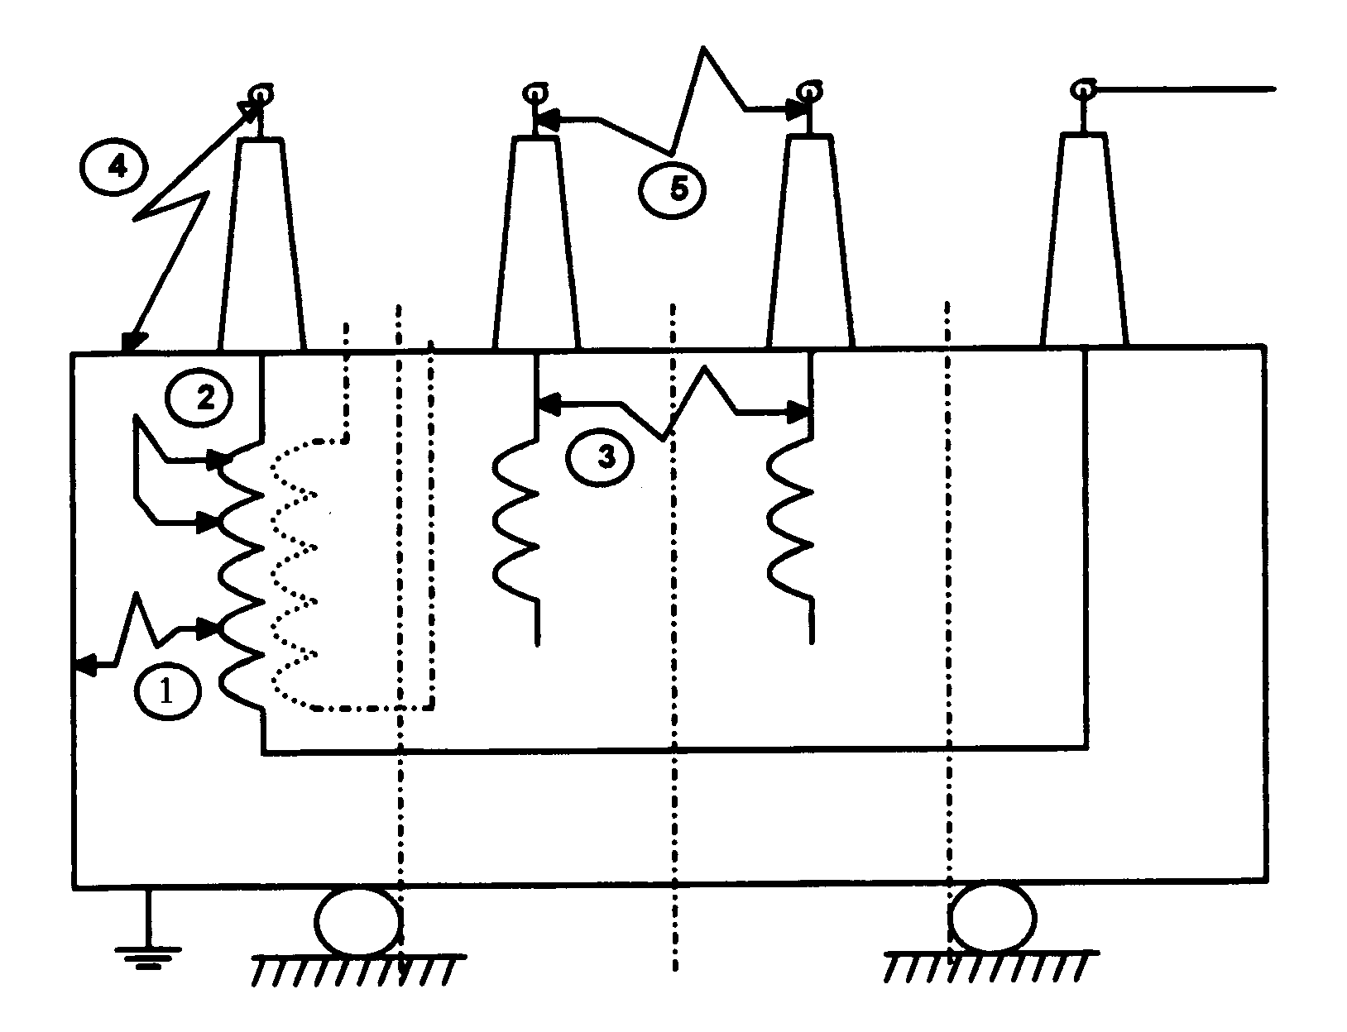
Transformer fault types
Internal electrical faults:
① Phase to earth fault and
accordingly earth faults
② Turn to turn faults
③ Short Circuits between phases
External electrical faults:
④ Phase to earth fault and
accordingly earth faults
⑤ Short Circuits between phases
Non electrical faults:
Loss of the Oil Supply
Loss of the Cooling

Slide 7

Overcurrent & Earthfault Protection

Slide 8
Transformer Overcurrent Protection
Requirements
  Fast operation for primary short circuits
  Discrimination with downstream protections
  Operation within transformer withstand
  Non-operation for short or long term overloads
  Non-operation for magnetising inrush

Slide 9
Use of Overcurrent Protection
HV
Source
LV
50
51
50 set to 1.2 - 1.3 x through fault level

Slide 10
Earthfault Protection and challenges

Slide 11
Transformer Ratio reminder:
Assuming Phase to phase Voltage are equal : U1=U2
Then ratio of Phase to ground voltage , V1 & V2 is:
Transformer ratio is :
Notes:
If the fault is a single end fed fault, the primary current should be greater than 0.2pu (Is1 default setting) for the differential protection to operate. Therefore,

Slide 12
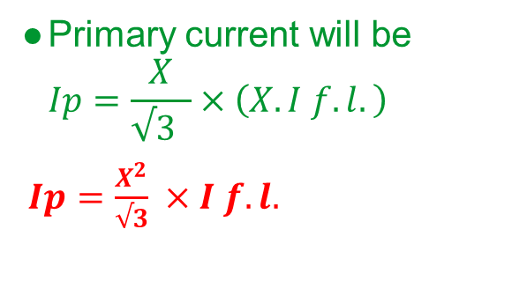
Earth fault on Transformer Winding
√3 p.u. turns
1 p.u. turns
I_{P}
x
PR
R
I_{F}
Protective
Relay
Resistor will limit EF.
For fault at X , current is:
IF = X. I F.L. (I full load)
Effective Transformer ratio is:
Ratio= √3 :X
Primary current will be
$Ip=\frac{X}{√3 }×\left(X. I f.l.\right)$
$Ip=\frac{X^{2}}{√3} ×I f.l.$

Slide 13
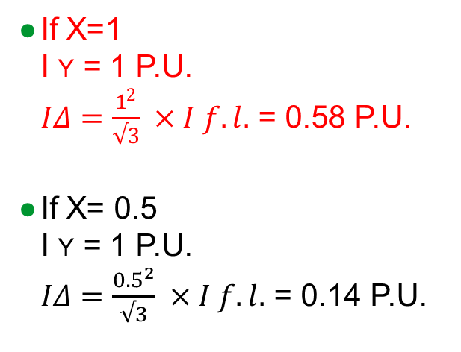
Overcurrent Relay Setting > I_{F.L.}
I_{f} as multiple
of I_{F.L.}
I_{F}
χ
1.0
0.9
0.8
0.7
0.6
0.5
0.4
0.3
0.2
0.1
51
Star Side
Overcurrent
Relay
If X=1
I Y = 1 P.U.
$IΔ=\frac{1^{2}}{√3} ×I f.l.$ = 0.58 P.U.
If X= 0.5
I Y = 1 P.U.
$IΔ=\frac{{0.5}^{2}}{√3} ×I f.l.$ = 0.14 P.U.
Delta Side
χ _{p.u..}
0.1 0.2 0.3 0.4 0.5 0.6 0.7 0.8 0.9 1.0
Overcurrent Relay Setting > I_{F.L.}

Slide 14
Restricted Earth Fault
REF

Slide 15
Restricted Earth Fault Protection:
Enhanced Ground Fault Sensitivity

Slide 16
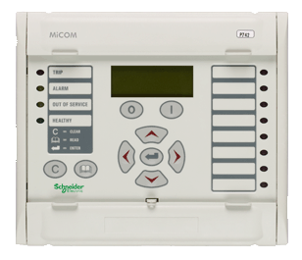
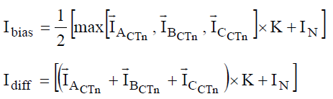
Low Impedance REF Protection
HV+LV
calculation of differential and
mean bias currents is as follow.
Notes:
Scaling factor = neutral CTR/ Line CTR
Qn: What relay is this based on ?

Slide 17
Un-Restricted Earthfault

Slide 18
Unrestricted Earthfault Protection (1)
51N
51
51
51
- Provides back-up protection for system
- Time delay required for co-ordination

Slide 19
Unrestricted Earthfault Protection (2)
51N
51
51
51
51N
- Can provide better sensitivity
(C.T. ratio not related to full load current)
(Improved “effective” setting)
- Provides back up protection for transformer and system

Slide 20
Differential Protection

Slide 21
Differential Protection
Overall differential protection may be justified for larger transformers (generally > 5MVA).
Provides fast operation on any winding
Measuring principle :
Based on the same circulating current principle as the restricted earth fault protection
However, it employs the biasing technique, to maintain stability for heavy thro’ fault current
Biasing allows mismatch between CT outputs.
It is essential for transformers with tap changing facility.
Another important requirement of transformer differential protection is immunity to magnetising inrush current.

Slide 22
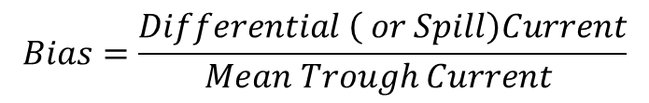
Biased Differential Scheme
Differential
Current
I₁ - I₂
I₁
BIAS
BIAS
I₂
OPERATE
I₁ - I₂
OPERATE
RESTRAIN
I₁ + I₂
2
Mean Thro Current
$$Bias=\frac{Differential \left( or Spill\right)Current}{Mean Trough Current }$$

Slide 23
Transformer Differential (87T)
Biased differential characteristic
Characteristic equations:

Slide 24
Stability for Magnetising Inrush Current
Magnetizing inrush current flows into the one winding during energization.
This current is not represented as outfeed on other windings
and appears on one side of transformer only
Seen as fault by differential relay
A method of restraint is required to avoid trips on closure of the breaker:
  Inrush current is rich in harmonics: 2nd, 5th etc.
  Use 2nd harmonic as the basis to detect inrush
Low set differential element is conditioned to check that the differential current is not inrush
High set differential elements do not wait for the inrush calculation

Slide 25
Typical Magnetising Inrush Waveforms
A
B
C

Slide 26
Transformer Differential (87T)
Inrush stabilisation (second harmonic blocking)
Notes:
Drop off means to assign cero to the second harmonic blocking DDB signals.

Slide 27
Transformer Differential (87T)
Fifth harmonic restraint

Slide 28
Differential Protection
PROTECTED ZONE
HV
LV
R
Correct application of differential protection requires CT ratio and winding connections to match those of transformer.
CT secondary circuit should be a “replica” of primary system.
Consider :
(1) Difference in current magnitude
(2) Phase shift
(3) Zero sequence currents

Slide 29
Vector Group, Ratio Mismatch and Zero-Sequence Compensation (1)
Power transformer
Ratio
correction
P640
Scheme
Vectorial
correction
Zero Seq.
trap
87T
Software Compensation
Software Compensation

Slide 30

Vector Group, Ratio Mismatch and Zero-Sequence Compensation (2)
Setting Wizard
+ Hour(s)
Enter reference power (Sn): MVA
Enter line voltage for each winding
Enter CT primary and secondary current ratings
Enter Vector Group (Clock Notation) for LV and TV windings
Set which windings are grounded. The relay applies a zero sequence filter (“Delta trap”) if the winding is grounded.
All you have to do: Set Transformer Nameplate Data, and CT Ratios

Slide 31
Transformers Connections
- “Clock Face” numbers refer to position of :
low voltage phase-neutral vector with respect to
high voltage phase-neutral vector
- Line connections made to highest numbered winding terminal available ( A2, a2,..)
- Line phase designation is same as winding
Example 1 : Dy 11 Transformer
High Voltage
Windings
Low Voltage
Windings
A Phase
Windings
B Phase
Windings
C Phase
Windings
A2
A1
a1
a2
B2
B1
b1
b2
C2
C1
c1
c2
Question : How to connect windings ?

Slide 32
Transformers Connections
1. Draw Phase-Neutral Voltage Vectors
a
A
⬅ Line Designation ➔
30°
b
C
B
c

Slide 33
Transformers Connections
2. Draw Delta Connection
A
a
b
C
B
c

Slide 34
Transformers Connections
3. Draw A Phase Windings
A
a
a2
A2
a1
b
A1
C
B
c

Slide 35
Transformers Connections
4. Complete Connections (a)
A
a
a2
C1
A2
a1
c1
b
b1
b2
C2
A1
B1
B2
c2
C
B
c

Slide 36
Transformers Connections
4. Complete Connections (b)
A
a
A2
A1
a1
a2
B
b
B2
B1
b1
b2
C
c
C2
C1
c1
c2

Slide 37
Transformer Vector Groups
Group 1
Yy0
Dd0
Zd0
0
Phase displacement
Group 2
Yy6
Dd6
Dz6
180
Phase displacement
Group 3
Yd1
Dy1
Yz1
30
Lag phase displacement
Group 4
Yd11
Dy11
Yz11
30
Lead phase displacement

Slide 38
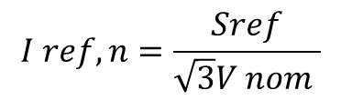


Transformer Ratio Correction, reference current :
100 MVA
3000:5
230 KV
400:5
13.8 KV
251 A
4184 A
87T
$$I ref,n=\frac{Sref}{\sqrt{3}V nom }$$
$I ref,HV=\frac{100 MVA}{\sqrt{3}. 230KV }$ = 251 A
$I ref,LV=\frac{100 MVA}{\sqrt{3}x 13.8KV }$ = 4184 A

Slide 39




Transformer Ratio Correction, Matching factor :
100 MVA
3000:5
230 KV
400:5
13.8 KV
251 A
4184 A
6.973 A
3.1375 A
X 1.593
= 5 A
87T
X 0.717
= 5 A
$$I\sec{HV }=\frac{Iref HV}{CTR HV }=\frac{251}{{400}/5 }=3.1375 A$$
$$I\sec{LV }=\frac{Iref LV}{CTR LV }=\frac{4184}{{3000}/5 }=6.973 A$$
$$K amp HV=\frac{I nom}{I ref }=\frac{5}{3.1375 }=1.593$$
$$K amp LV=\frac{I nom}{I ref }=\frac{5}{6.973 }=0.717$$

Slide 40
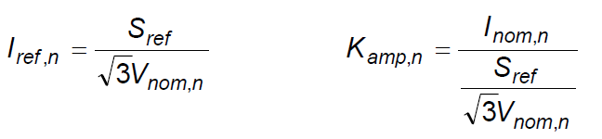
Transformer Ratio Correction summary:
The P64x calculates the ratio correction factors on the basis of the reference power, winding nominal voltage, and primary nominal currents of the current transformers.
Sref: common reference power for all ends
n: is CT1, CT2, CT3, CT4, CT5 for each of the CT inputs
Iref,n: reference current for the respective CT input
Kamp,n: amplitude-matching factor for the respective CT input
Inom,n: primary nominal currents for the respective CT input
Vnom,n: primary nominal voltage for the respective CT input
The P64x checks that the matching factors are within their permissible ranges.
The matching factors must satisfy the following condition:
The matching factors must always be 0.05 < Kamp,n < 20

Slide 41
Use of Interposing CT
P1 P2 A2 A1 a1 a2 P2 P1
S1 S2
S1 S2
S2 S1 P1 P2
R
R
R
Interposing CT provides :
Vector correction
Ratio correction
Zero sequence compensation

Slide 42
Vector Group, Ratio Mismatch and Zero-Sequence Compensation (3)
Interposing CTs NOT REQUIRED

Slide 43
Current Distributions

Slide 44
Fault Currents on High and Low Side
I
a₁
a₂
A₂
A₁
B₂
b₁
b₂
B₁
Source
C₂
C₁
c₁
c₂
I
I
I
Ph-G Fault

Slide 45
Fault Currents on High and Low Side
A₂
A₁
a₁
a₂
I
B₂
B₁
b₁
b₂
Source
I
I
I
C₂
C₁
c₁
c₂
2I
I
I
Ph-Ph Fault

Slide 46
External A-N Fault Current Distribution

Slide 47
Differential CTS (CT Supervision)

Slide 48
P64x Differential CTS (1)
Patent Number US7279905
The ratio of Negative (I2) to Positive (I1) sequence current is measured for each CT input.
  Ratio is zero (or small) => CT is unloaded OR balanced load is flowing, OR a three phase system fault is present.
  Ratio is non-zero => An unbalanced fault exists, OR there is unbalanced loading, OR there is a CT problem.
  Ratio is non-zero at two (or more ends) simultaneously => Almost certainly a genuine fault condition & unlikely to be a CT problem.
The output of the AND gate is HIGH only if CTS I2/I1>2 of CT1 is high and I2/I1 ratio in all the other current inputs is below the standing unbalance of the system.
Notes:
Question : What ‘CT Problems’ are identified ? Short Circuit ? Open circuit ?
Slide 25 : What’s the condition on the inputs to the AND gates ?

Slide 49
P64x Differential CTS (2)
If I2/I1 ratio is high at one end only, the output from the AND gate A highlighted in red is asserted.
The relay uses I1 to distinguish between a CT problem and a single end fed fault condition:
  If I1 is detected at more than one end, it must be a CT problem and CTS is allowed to operate
  If I1 is detected at only one end, it is either inrush condition or single end fed internal fault. Therefore, the CTS operation is blocked
Notes:
Question : The Appln Notes mention ‘long time delay’ to detect CT failure !!
Question :

Slide 50
Differential CTS - Principles (3)
Simplified Logic Diagram
Typical settings:
CTS I2/I1>2 = 40%
CTS I2/I1>1 = 20%
CTS I1 = 10%
CTS time delay = 1sec
Notes:
The positive sequence current in at least two current inputs exceeds CTS I1 setting. CTS I1 setting should be below the minimum load current of the protected object. Therefore, 10% of the rated current might be used.
The high set ratio of negative to positive sequence current, CTS I2/I1>2, should be set below the ratio of negative sequence to positive sequence current for the minimum unbalanced fault current. A typical setting of 40% is might be used.
The low set ratio of negative to positive sequence current, CTS I2/I1> 1, should be set above the maximum load unbalance. In practice, the levels of standing negative phase sequence current present on the system govern this minimum setting. This can be determined from a system study, or by making use of the relay measurement facilities at the commissioning stage. If the latter method is adopted, it is important to take the measurements during maximum system load conditions, to ensure that all single-phase loads are accounted for. A 20% setting might be used.
If the following information is recorded by the relay during commissioning:
Ifull load = 500A
I2 = 50A
Therefore I2/I1 ratio is given by I2/I1 = 50/500 = 0.1
To allow for tolerances and load variations a setting of 20% of this value may be typical. Therefore set CTS I2/I1>1 = 20%.
Since sensitive settings have been employed a long time delay is necessary to ensure a true CT failure. A 60 second time delay setting may be typical.

Slide 51
Patented CT Supervision (3)
Option: Indication or Restrain
CTS impact on 87T depends on setting:
Alarm Mode: Indication only
Restrain Mode: Is-CTS de-sensitise to avoid a trip on max. load

Slide 52
Typical Schemes

Slide 53
Up to 1MVA
3.3kV
200/5
51
50
51
50
N
N
1MVA
3.3/0.44kV
1500/5
51
N
64
1500/5

Slide 54
1 - 5MVA
11kV
51
50
64
5MVA
11/3.3kV
1000/5
51
N
64
1000/5
3.3kV

Slide 55
Above 5MVA
33KV
51
50
200/5
P120
10MVA
33/11KV
51
N
87
600/5
64
600/5
5/5A

Slide 56
Conventional Two Winding Input Applications
MiCOM P642/P632
HV+LV
P642

Slide 57
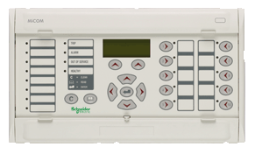
Three Bias Input Applications
MiCOM P643
HV+LV+TV
HV+LV
P643
P643

Slide 58
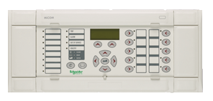
Application for Transformers with Dual CT Inputs Per Winding: MiCOM P645
HV+LV+TV
P645

Slide 59

Thank You

